Slide 1

Technical Writing and Presentation Skills
Dr. Qamaruddin Memon

Slide 2

Importance of Visual Aids
In a technical writing course, Visual aids helps to convey the message with the help of visible things.

Slide 3

What is Visual Aids

Slide 4
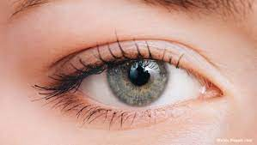
Visible
(Can be seen)

Slide 5


Aid
(help, assist)

Slide 6
Visual aids
Technical writers use visual aids for four purposes:
To summarize data
To give users an opportunity to explore data
To provide a different entry point into the discussion
To engage user expectations

Slide 7
Reporting Results
After analyzing data, in result, the aim is to present and describe the results in a systematic and detailed way.
In quantitative studies, the results section is likely to consist of tables and figures, and writers comment on the significant data shown in these.
This often takes the form of the location or summary statement, which identifies the table or figure and indicates its content, and a highlighting statement or statements, which point out and describe the relevant or significant data.

Slide 8
Reporting Results
All figures and tables should be numbered and given a title. More elaborate commentary on the results is normally restricted to the Discussion section.
In research articles, however, authors may comment extensively on their results as they are presented, and it is not uncommon for the Results section to be combined with the Discussion section under the heading: Results and Discussion.

Slide 9
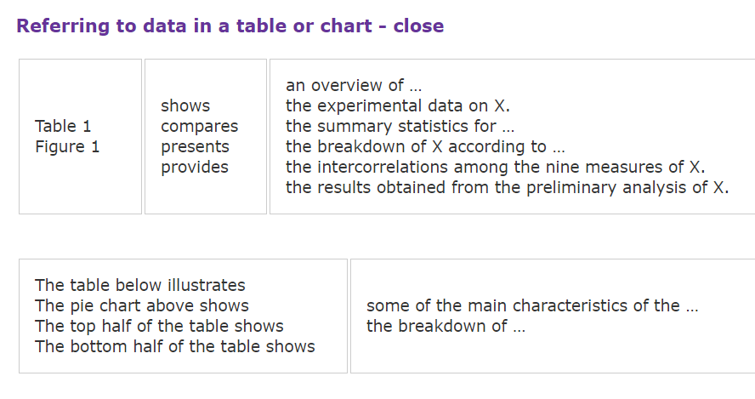

Slide 10
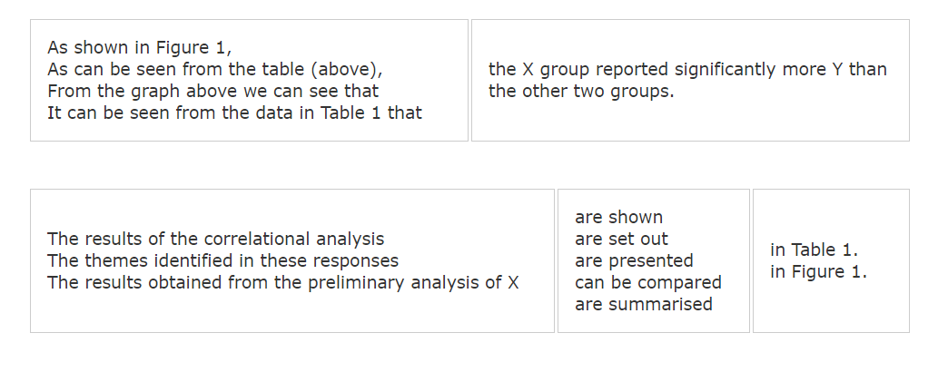

Slide 11
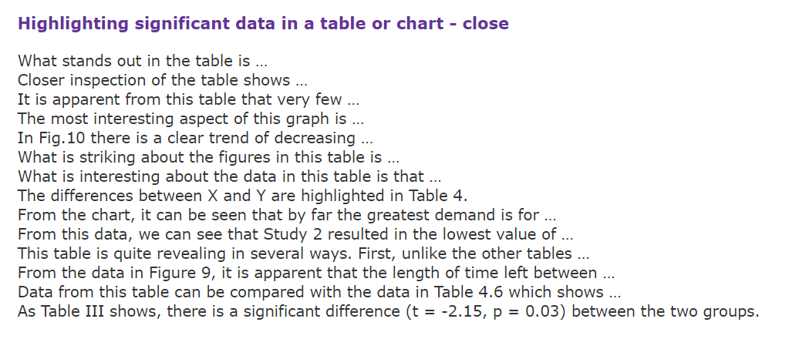

Slide 12
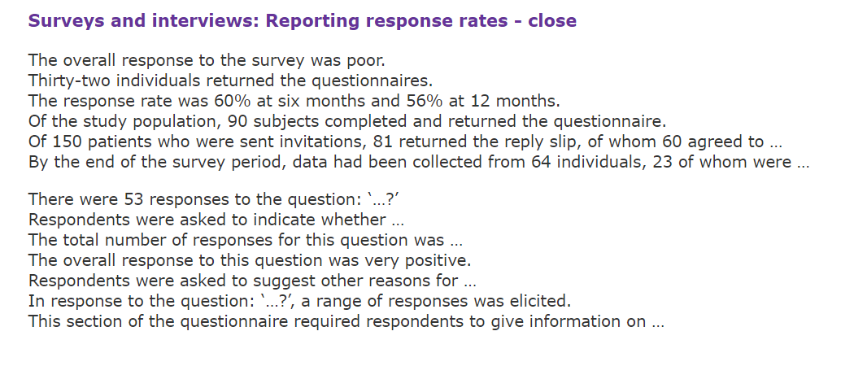

Slide 13
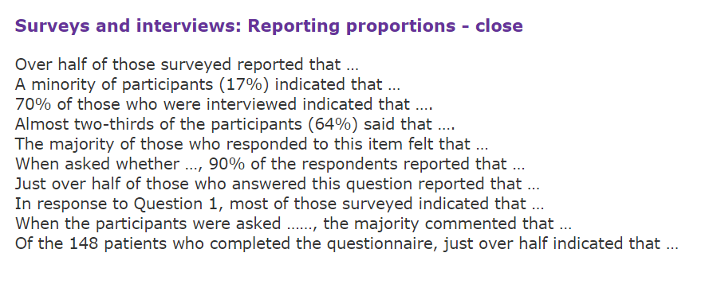

Slide 14
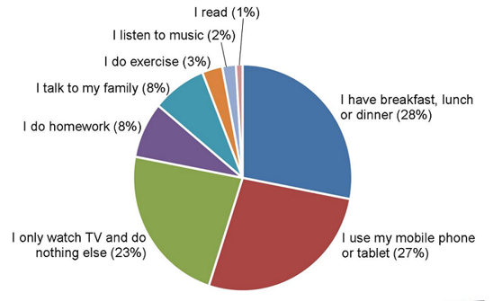
A pie chart uses segments of a circle to indicate percentages of a total. The whole circle represents 100 percent, the segments of the circle represent each item’s percentage of the total, and the callouts identify the segments in the graph. Data words or symbols provide detailed information.
When to use:
To compare components to one another
To compare components to the whole

Slide 15
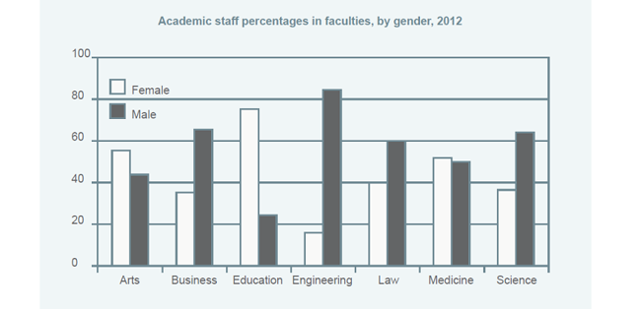
A bar chart or bar graph can be used to compare either different items in general, as in this example, or to show change over time, where the horizontal axis shows dates and the vertical axis shows quantity.

Slide 16
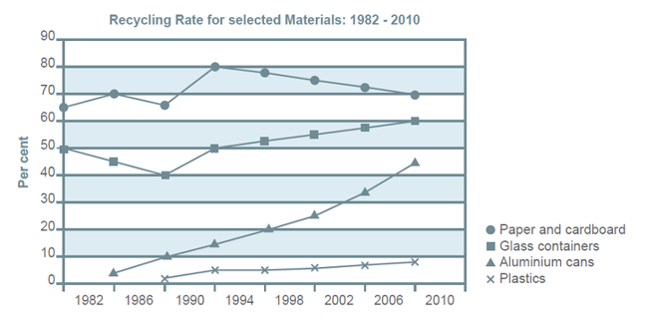
A line graphs usually show trends over time, such as profits or losses from year to year (with the dates or times on the horizontal axis and whatever unit is being measured, e.g. number, percentage, cost etc. on the vertical axis.)

Slide 17
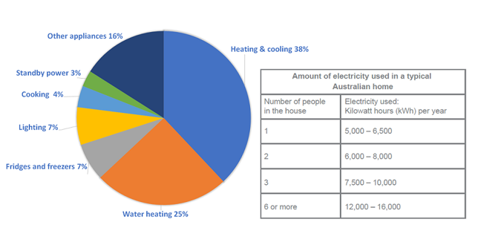
A table is a collection of information expressed in numbers or words and presented in columns and rows.
Tables are another way of showing numerical data, and these are often provided together with a graph or chart to show additional information or details or make comparisons.

Slide 18

Static Data Vs Dynamic Data

Slide 19
Some key points to remember
Write a clear introduction paraphrasing the question and describing exactly what you will be reporting on.
Write an overview. No matter what type of data you are given, you must summarize the main points in one or two sentences, called the overview. (The most important features of the information.)
Follow the instructions exactly. You are asked to summaries the information, report the main features and make comparisons. You can also analyze the data, interpret it or explain it.
Make sure you write enough.

Slide 20
Ways of expressing numbers
Smaller numbers can be written as words or digits, e.g. twenty-five or 25, while larger numbers can be written as digits or a combination of digits and words. For example, 1,500,000 could be written as 1.5 million.
Numbers containing words such as thousand, million etc. are always singular.
Also, the fact that the decimal point in English is written as a comma in some languages (and vice versa) can cause confusion. 3,142 is three thousand one hundred and forty two in English.

Slide 21
Proportion
There are basically two ways to talk about proportions. You can use fractions, such as ‘a half’ or ‘½’, or you can use percentages - 50% or fifty percent. You can do this in the following ways:
Slightly greater= just over 50%/half, a little over 50%/half, slightly over 50%/half.
Slightly less = just under, a little under, slightly under. You could also say ‘almost 50%’.
Unsure of the exact amount = ‘about/approximately/around/roughly 50%’.
Emphasize a larger difference= ‘well under/over’. For example, ‘well over 50% of customers returned for a second visit’.

Slide 22
Quantifiers
While you should report some precise numbers, especially if they are significant, you should not report every number. Often it is best to use quantifiers to describe approximate numbers or amounts.
For countable nouns you can use: a large number of, a significant number of, several, a small number of or a few.
For uncountable nouns you can use: a large amount of, a great deal of, a significant amount of, a small amount of, a little.
You can use some and a lot of with both countable and uncountable nouns and no or none for zero.

Slide 23
The language of comparisons
more/less/fewer - these can be modified with a little/slightly/a lot/far/considerably
much/many
Examples
Teenagers spend more time on social media than any other age group.
In 2018 there were 500 fewer road accident deaths than in 2017.
The UK spent slightly less than France.
twice/three times/four times as much/many; half as much/many
Examples
15-18 year olds spent twice as much time online as 18-21 year olds.
There were three times as many accidents in December.

Slide 24
The language of comparisons
3. A larger/greater number/amount
Examples
A greater number of people travelled abroad in 2017 than in any previous year.
The USA consumed a larger amount of oil per capital than any other country.
4. Linking and contrasting two examples by using while, whereas etc.
Example
While unemployment went down by 3% in France, it increased by 5% in Spain.

Slide 25
Language for describing trends
Verbs to describe a general increase
Go up
Rise
Increase
Climb
Verbs to describe a sudden, large increase
Jump
Shoot up
Rocket
Verbs to describe a general decrease
Go down
Fall
Decrease
Drop
Verbs to describe a large decrease
Plunge
Plummet

Slide 26
Language for describing trends
Speed
A change that happens quickly, you can also use rapidly or sharply.
A change that happens slowly, you can also use gradually.
A change that happens by approximately the same amount each month/year etc. you can use steadily.
Amount
A large increase or decrease, you can use considerably, significantly or substantially.
A smaller increase or decrease, you can use slightly or moderately.

Slide 27
Language for describing trends
Other useful expressions
Finally, there are a number of other useful expressions to describe particular changes:
If a value goes up and down repeatedly, we say it fluctuates.
If a value stays the same for a period of time, we can say that it remains stable.
If it fluctuates, then stops fluctuating, we can say it stabilizes or levels off.
If a number reaches a high point and then drops back again, we can say it peaks at a certain number or reaches a peak. For example, ‘the share price peaked at $115’ or ‘the share price reached a peak of $115.’

Slide 28
Key points to remember
Other graphs may show times of the day, days of the week, months or other periods. In those cases you need to check if there is a year included in the information. If there is, then you will use the past simple to describe the data.
If there is not, then it is describing daily, weekly or monthly figures in general and you would use the present simple.
It is also possible that you could get a forecast of the future, and have to use ‘will’.

Slide 29
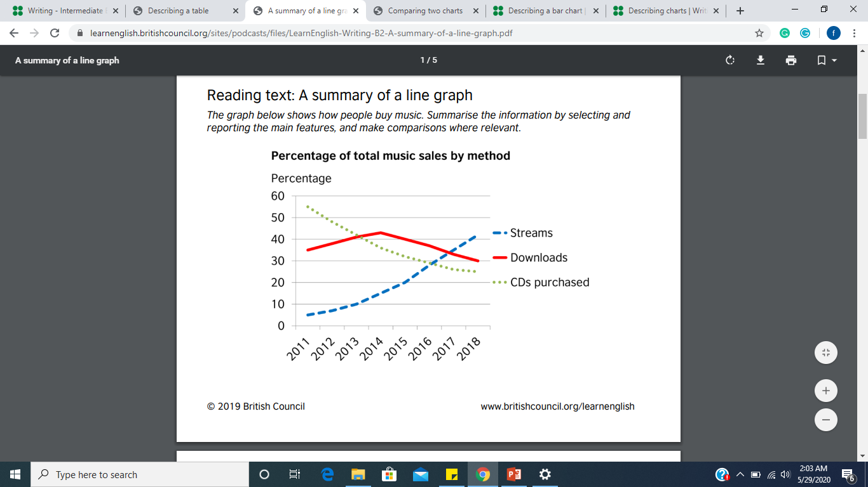
Practice:

Slide 30
Tips
Change the words in the question to introduce your answer, e.g. This graph shows = This graph illustrates.
The second paragraph should give an overview of the main points the graph shows (imagine you’re describing the results to someone who can’t see the graph).
The following paragraphs should describe the main patterns or trends in more detail.
Use precise vocabulary like steadily declined and a sharp increase to describe trends. Use linking expressions like while and in contrast to make comparisons.

Slide 31
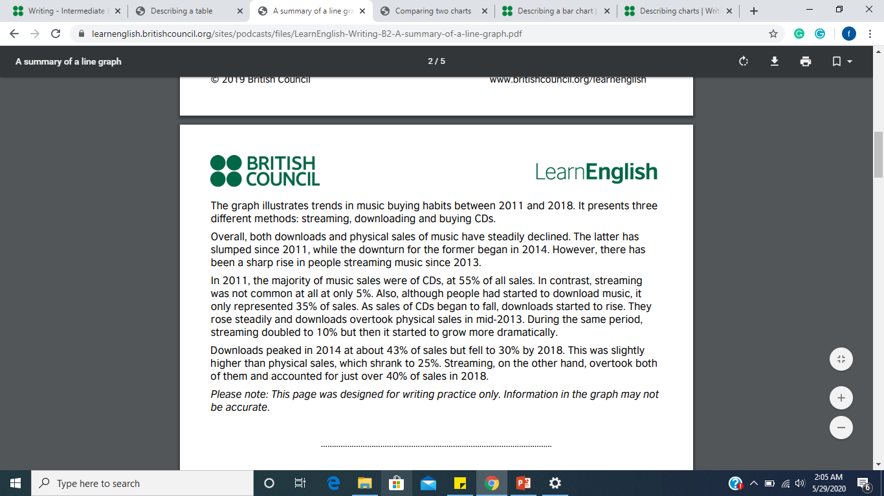
Possible Solution

Slide 32
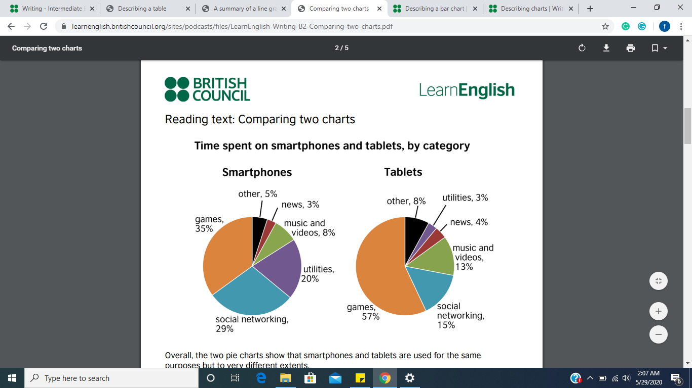

Slide 33
Tips
Before writing about the detailed figures, give an overview of what the graphs or charts represent.
Say precisely what the data refers to. There is a difference between, for example, a user spending 57% of their time on games and a user spending 57% of their tablet time on games. (You can write % or per cent, but be consistent.)
You don’t need to describe all the information in the diagrams. Select the most important things.
Don’t repeat vocabulary. Use different words and phrases with the same or similar meanings, e.g. playing games = gaming.
Use transition words/ Linking expression for Compare & Contrast.

Slide 34
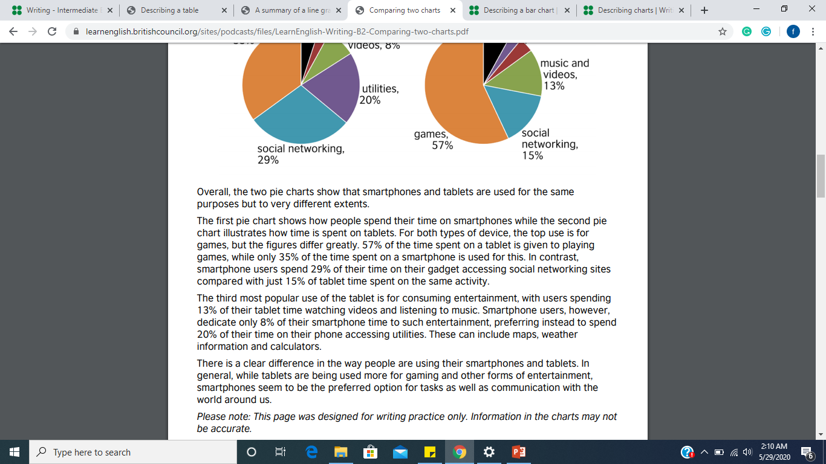
Possible Solution

Slide 35
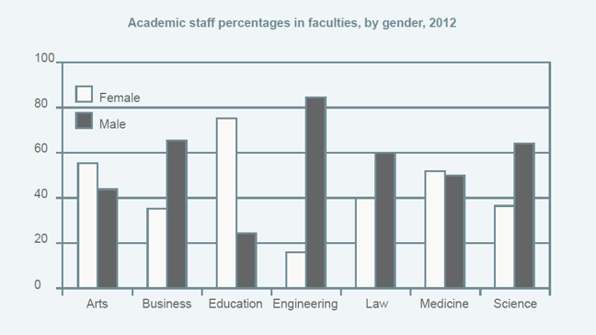
Over to you . . .
The graph shows the percentage of male and female academic staff members across the faculties of a major university in 2012. Summaries the information by selecting and reporting the main features, and make comparisons where relevant.

